Slide 2
COMP 3500 Introduction to Operating Systems Process Management: Process Control
Dr. Xiao Qin
Auburn University http://www.eng.auburn.edu/~xqin
xqin@auburn.edu
Notes:
Fall18:
30 Min 09a-this slide sets 1-12 (09a).
10 Min 09b slides 1-5. to be continued from slides 6 as 10a.
Fall’17:
25 Min 07a-how to modify OS161
25 Min 07b-this slide sets 1-12.
Spring’17: 45 Minutes Slides 1-17.
In Fall’16: 50 Minutes Slides 1-25. Quickly finish all the 9 exercises in the handout.
Slides 25-31 are backup slides.
12 Minutes Lec02c Project 2 details cont
30 Minutes Slides 1-14

Slide 3
Recap: What is a process?
An instance of a program in execution.
Applications vs. Processes
Grocery Lists vs. Go Shopping
Notes:
Analagy Example
A programmer is going to the grocery store...
A programmer is going to the grocery store and his wife tells him, "Buy a gallon of milk, and if there are eggs, buy a dozen." So the programmer goes, buys everything, and drives back to his house. Upon arrival, his wife angrily asks him, "Why did you get 13 gallons of milk?" The programmer says, "There were eggs!"
Only four words: a program in execution.
Must use a minimal of five chinese characters to define process.
Now that we have the concepts of applications, system software, and resources,
we are in a position to discuss how the OS can, in an orderly fashion, manage the
execution of applications so that
• Resources are made available to multiple applications.
• The physical processor is switched among multiple applications so all will
appear to be progressing.
• The processor and I/O devices can be used efficiently.
The approach taken by all modern operating systems is to rely on a model in
which the execution of an application corresponds to the existence of one or more
processes.

Slide 4
Process Elements: Data Structures
Review: While the program is executing, what elements can uniquely characterize its process?
identifier
state
priority
program counter
memory pointers
context data
I/O status information
accounting information
Notes:
At any given point in time,
while the program is executing , this process can be uniquely characterized by a
number of elements, including the following:
• Identifier: A unique identifier associated with this process, to distinguish it
from all other processes.
• State: If the process is currently executing, it is in the running state.
• Priority: Priority level relative to other processes.
• Program counter: The address of the next instruction in the program to be
executed.
• Memory pointers: Includes pointers to the program code and data associated
with this process, plus any memory blocks shared with other processes.
• Context data: These are data that are present in registers in the processor
while the process is executing.
• I/O status information: Includes outstanding I/O requests, I/O devices (e.g.,
disk drives) assigned to this process, a list of files in use by the process, and
so on.
• Accounting information: May include the amount of processor time and clock
time used, time limits, account numbers, and so on.

Slide 5
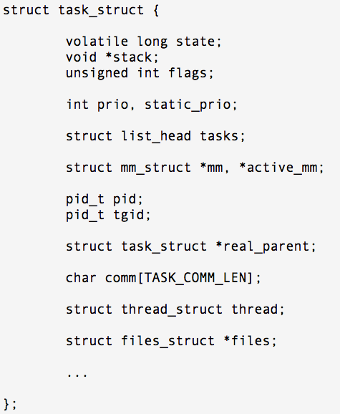
Process Control Block
Contains the process elements
It is possible to interrupt a running process and later resume execution as if the interruption had not occurred
Created and managed by the operating system
Key tool that allows support for multiple processes
Can you design a data structure for PCB?
Notes:
Show Lec03a task_struct in linux sched.h
3100 lines of source code.
struct task_struct {
};
Has over 436 lines (from line 1292-1727).
The information in the preceding list is stored in a data structure, typically
called a process control block ( Figure 3.1 ), that is created and managed by the OS.
The significant point about the process control block is that it contains sufficient
information so that it is possible to interrupt a running process and later resume
execution as if the interruption had not occurred. The process control block is
the key tool that enables the OS to support multiple processes and to provide for
multiprocessing. When a process is interrupted, the current values of the program
counter and the processor registers (context data) are saved in the appropriate fields
of the corresponding process control block, and the state of the process is changed
to some other value, such as blocked or ready (described subsequently). The OS is
now free to put some other process in the running state. The program counter and
context data for this process are loaded into the processor registers and this process
now begins to execute.
Thus, we can say that a process consists of program code and associated data
plus a process control block. For a single-processor computer, at any given time, at
most one process is executing and that process is in the running state.

Slide 6
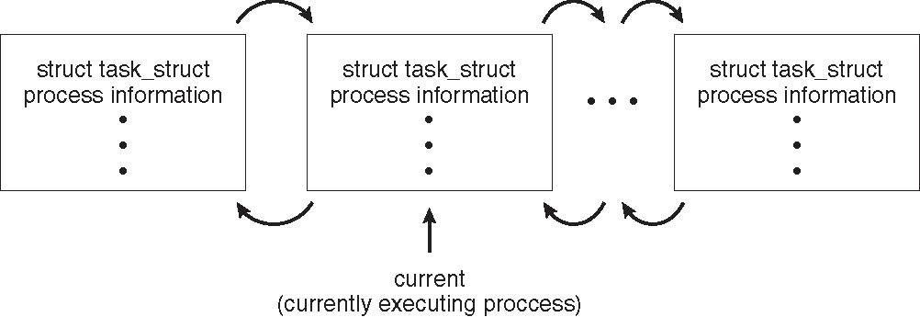
Process Representation in Linux
The C structure task_struct
pid t_pid; /* process identifier */ long state; /* state of the process */ unsigned int time_slice /* scheduling information */ struct task_struct *parent; /* this process’s parent */ struct list_head children; /* this process’s children */ struct files_struct *files; /* list of open files */ struct mm_struct *mm; /* address space of this process */

Slide 7
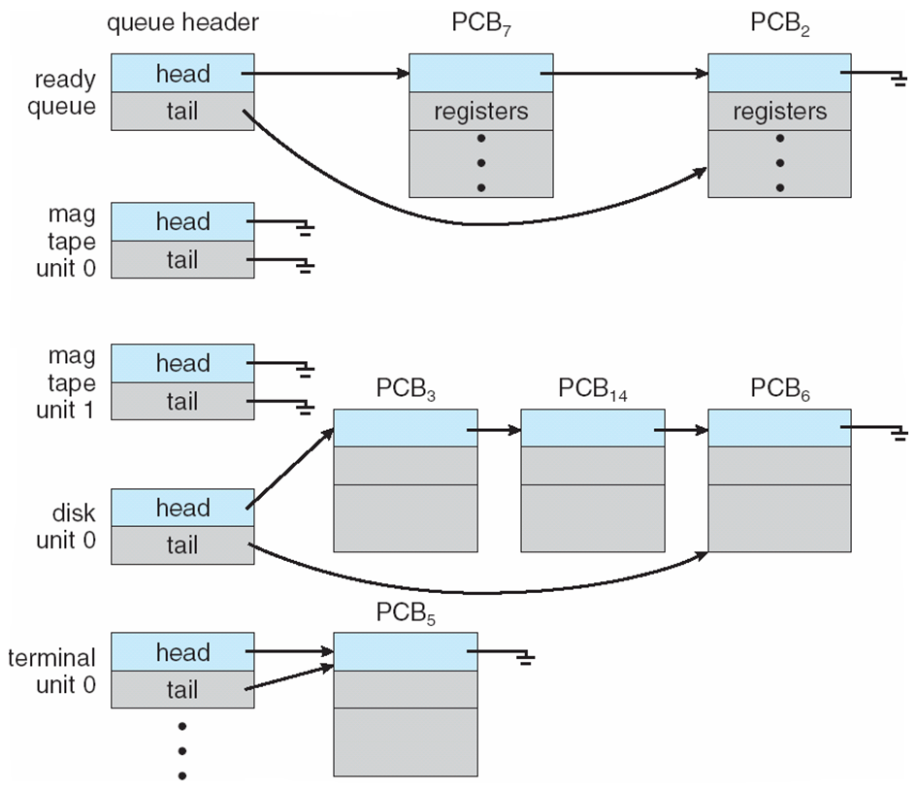
How to use PCB? Example 1: Ready Queue and Various I/O Device Queues

Slide 8
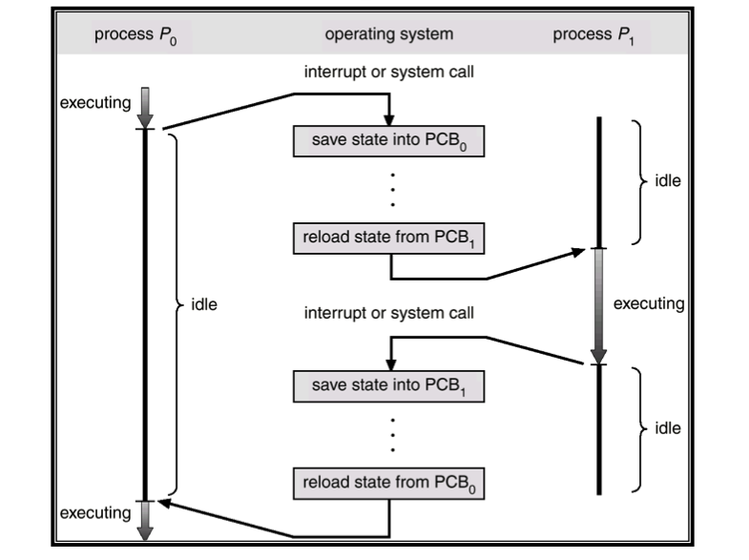
How to use PCB? Example 2: CPU Switch from Process to Process
Notes:
The information in the preceding list is stored in a data structure, typically
called a process control block ( Figure 3.1 ), that is created and managed by the OS.
The significant point about the process control block is that it contains sufficient
information so that it is possible to interrupt a running process and later resume
execution as if the interruption had not occurred. The process control block is
the key tool that enables the OS to support multiple processes and to provide for
multiprocessing. When a process is interrupted, the current values of the program
counter and the processor registers (context data) are saved in the appropriate fields
of the corresponding process control block, and the state of the process is changed
to some other value, such as blocked or ready (described subsequently). The OS is
now free to put some other process in the running state. The program counter and
context data for this process are loaded into the processor registers and this process
now begins to execute.
Thus, we can say that a process consists of program code and associated data
plus a process control block. For a single-processor computer, at any given time, at
most one process is executing and that process is in the running state.

Slide 9
Context Switch
When CPU switches to another process
OS must save the state of the old process
load the saved state for the new process via a context switch
Context of a process represented in the PCB
Exercise 5 (Plickers): The context-switch time is OS overhead. The context-switch overhead depends on the following factors except. (1 Minute)
A. The complexity of the OS and PCB B. Open source operating systems
C. Multiple sets of registers per CPU D. Multiple contexts loaded at once.
Notes:
When CPU switches to another process
OS must save the state of the old process
load the saved state for the new process via a context switch
Context of a process represented in the PCB
Context-switch time is overhead; the system does no useful work while switching
The more complex the OS and the PCB ➔ the longer the context switch
Time dependent on hardware support
Some hardware provides multiple sets of registers per CPU ➔ multiple contexts loaded at once
1. The complexity of the OS and the PCB
2. hardware support: e.g., multiple sets of registers per CPU; multiple contexts loaded at once

Slide 10
Reference: https://learnyousomeerlang.com/finite-state-machines

Slide 11
Two-State Process Model
Exercise 6: What are the two possible process states?
Notes:
The operating system’s principal responsibility is controlling the execution of
processes; this includes determining the interleaving pattern for execution and allocating
resources to processes. The first step in designing an OS to control processes
is to describe the behavior that we would like the processes to exhibit.
We can construct the simplest possible model by observing that, at any time, a
process is either being executed by a processor or not. In this model, a process may
be in one of two states: Running or Not Running, as shown in Figure 3.5a . When
the OS creates a new process, it creates a process control block for the process and
enters that process into the system in the Not Running state. The process exists,
is known to the OS, and is waiting for an opportunity to execute. From time to
time, the currently running process will be interrupted and the dispatcher portion
of the OS will select some other process to run. The former process moves from the
Running state to the Not Running state, and one of the other processes moves to
the Running state.

Slide 12
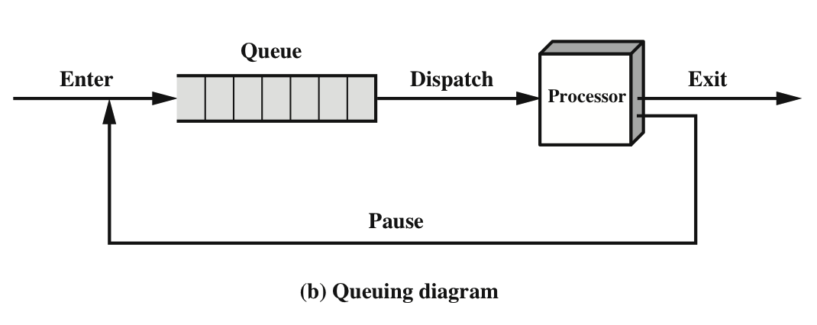
Two-State Process Model
Notes:
From this simple model, we can already begin to appreciate some of the design
elements of the OS. Each process must be represented in some way so that the OS
can keep track of it. That is, there must be some information relating to each process,
including current state and location in memory; this is the process control block.
Processes that are not running must be kept in some sort of queue, waiting their turn
to execute. Figure 3.5b suggests a structure. There is a single queue in which each
entry is a pointer to the process control block of a particular process. Alternatively,
the queue may consist of a linked list of data blocks, in which each block represents
one process; we will explore this latter implementation subsequently.
We can describe the behavior of the dispatcher in terms of this queuing
diagram. A process that is interrupted is transferred to the queue of waiting processes.
Alternatively, if the process has completed or aborted, it is discarded (exits
the system). In either case, the dispatcher takes another process from the queue to
execute.

Slide 13
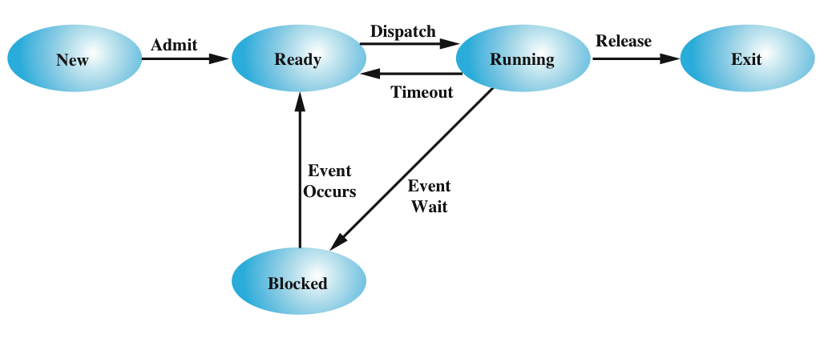
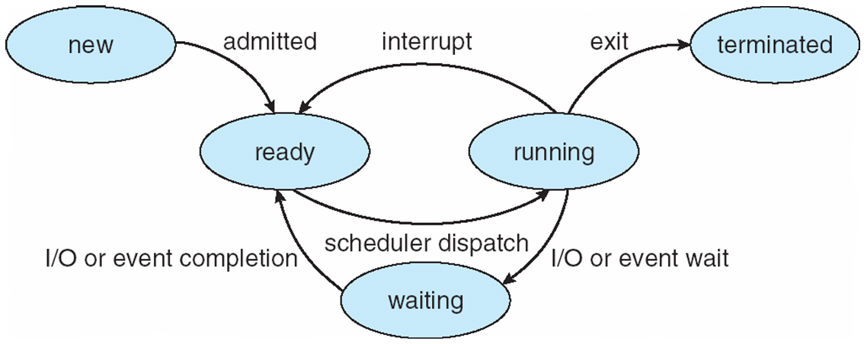
Five-State Process Model
Exercise 7: What are the five process states? What’s a difference between “ready” and “waiting”?
Notes:
Write on whiteboard:
Event-driven:
switch (event) {
case INTERRUPT:
if (state == RUNNING)
…
state = READY;
break;
if …
}
State-driven:
switch (state) {
case RUNNING:
if (event == INTERRUPT)
…
state = READY;
break;
if …
}
If all processes were always ready to execute, then the queuing discipline suggested
by Figure 3.5b would be effective. The queue is a first-in-first-out list and the processor
operates in round-robin fashion on the available processes (each process in
the queue is given a certain amount of time, in turn, to execute and then returned to
the queue, unless blocked). However, even with the simple example that we have
described, this implementation is inadequate: Some processes in the Not Running
state are ready to execute, while others are blocked, waiting for an I/O operation
to complete. Thus, using a single queue, the dispatcher could not just select the
process at the oldest end of the queue. Rather, the dispatcher would have to scan
the list looking for the process that is not blocked and that has been in the queue
the longest.
A more natural way to handle this situation is to split the Not Running state
into two states: Ready and Blocked. This is shown in Figure 3.6 .
The five states in this new diagram are:
• Running: The process that is currently being executed. For this chapter, we
will assume a computer with a single processor, so at most one process at a
time can be in this state.
• Ready: A process that is prepared to execute when given the opportunity.
• Blocked/Waiting: A process that cannot execute until some event occurs,
such as the completion of an I/O operation.
• New: A process that has just been created but has not yet been admitted to the
pool of executable processes by the OS. Typically, a new process has not yet
been loaded into main memory, although its process control block has been
created.
• Exit: A process that has been released from the pool of executable processes
by the OS, either because it halted or because it aborted for some reason.
Figure 3.6 indicates the types of events that lead to each state transition for a
process; the possible transitions are as follows:
• Null : New: A new process is created to execute a program. This event occurs
for any of the reasons listed in Table 3.1 .
• New : Ready: The OS will move a process from the New state to the Ready
state when it is prepared to take on an additional process. Most systems set
some limit based on the number of existing processes or the amount of virtual
memory committed to existing processes. This limit assures that there are not
so many active processes as to degrade performance.
• Ready : Running: When it is time to select a process to run, the OS chooses
one of the processes in the Ready state. This is the job of the scheduler or
dispatcher. Scheduling is explored in Part Four.
• Running : Exit: The currently running process is terminated by the OS if the
process indicates that it has completed, or if it aborts. See Table 3.2 .
• Running : Ready: The most common reason for this transition is that the
running process has reached the maximum allowable time for uninterrupted
execution; virtually all multiprogramming operating systems impose this type
of time discipline. There are several other alternative causes for this transition,
which are not implemented in all operating systems. Of particular importance
is the case in which the OS assigns different levels of priority to different
processes.
Running : Blocked: A process is put in the Blocked state if it requests something
for which it must wait. A request to the OS is usually in the form of a
system service call; that is, a call from the running program to a procedure
that is part of the operating system code. For example, a process may request
a service from the OS that the OS is not prepared to perform immediately. It
can request a resource, such as a file or a shared section of virtual memory,
that is not immediately available. Or the process may initiate an action, such
as an I/O operation, that must be completed before the process can continue.
When processes communicate with each other, a process may be blocked
when it is waiting for another process to provide data or waiting for a message
from another process.
• Blocked : Ready: A process in the Blocked state is moved to the Ready state
when the event for which it has been waiting occurs.
• Ready : Exit: For clarity, this transition is not shown on the state diagram. In
some systems, a parent may terminate a child’ process at any time. Also, if a parent
terminates, all child processes associated with that parent may be terminated.
• Blocked : Exit: The comments under the preceding item apply.

Slide 14
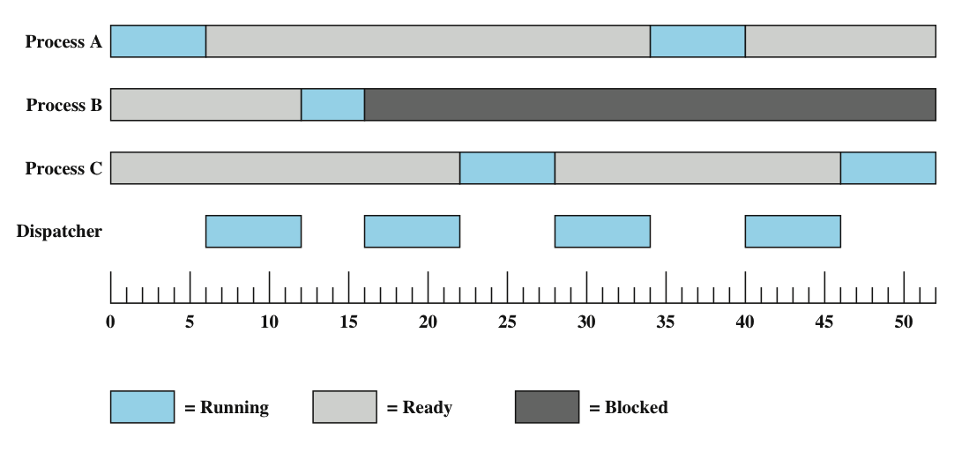
What is the dispatcher?
Notes:
Returning to our simple example, Figure 3.7 shows the transition of each process
among the states.

Slide 15
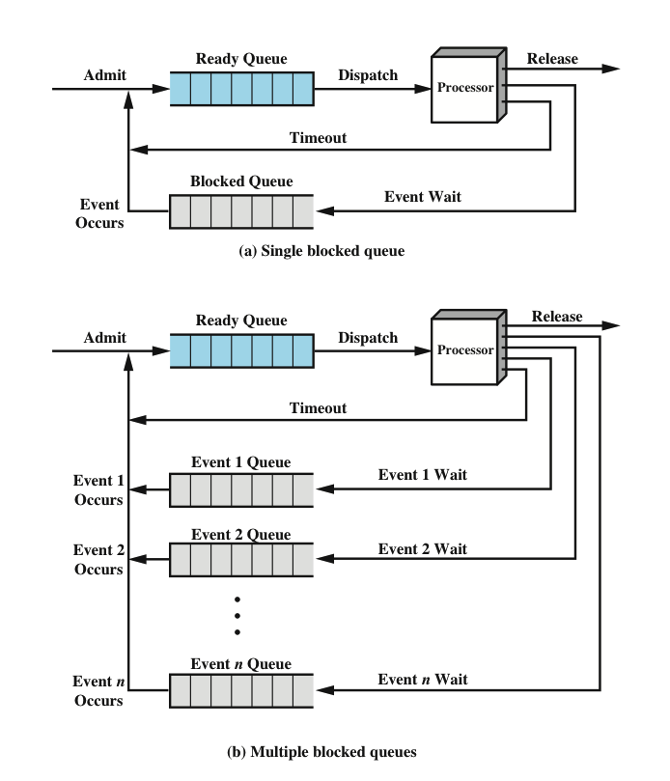
A Queuing Model
Exercise 8: What are maintained in each queue?
Notes:
Figure 3.8a suggests the way in which a queuing discipline
might be implemented with two queues: a Ready queue and a Blocked queue. As
each process is admitted to the system, it is placed in the Ready queue. When it is
time for the OS to choose another process to run, it selects one from the Ready
queue. In the absence of any priority scheme, this can be a simple first-in-first-out
queue. When a running process is removed from execution, it is either terminated
or placed in the Ready or Blocked queue, depending on the circumstances. Finally,
when an event occurs, any process in the Blocked queue that has been waiting on
that event only is moved to the Ready queue.
This latter arrangement means that, when an event occurs, the OS must scan
the entire blocked queue, searching for those processes waiting on that event. In a
large OS, there could be hundreds or even thousands of processes in that queue.
Therefore, it would be more efficient to have a number of queues, one for each
event. Then, when the event occurs, the entire list of processes in the appropriate
queue can be moved to the Ready state ( Figure 3.8b ).
One final refinement: If the dispatching of processes is dictated by a priority
scheme, then it would be convenient to have a number of Ready queues, one for
each priority level. The OS could then readily determine which is the highest-priority
ready process that has been waiting the longest.

Slide 16
Suspended Processes: Swapping
Moving part of all of a process from main memory to disk
When none of the processes in main memory is in the Ready state, the OS swaps one of the blocked processes out on to disk into a suspend queue
Notes:
Recall that the reason for all of this elaborate machinery is that I/O activities
are much slower than computation and therefore the processor in a uniprogramming
system is idle most of the time. But the arrangement of Figure 3.8b does not entirely
solve the problem. It is true that, in this case, memory holds multiple processes and
that the processor can move to another process when one process is blocked. But the
processor is so much faster than I/O that it will be common for all of the processes in
memory to be waiting for I/O. Thus, even with multiprogramming, a processor could
be idle most of the time.
What to do? Main memory could be expanded to accommodate more processes.
But there are two flaws in this approach. First, there is a cost associated with
main memory, which, though small on a per-byte basis, begins to add up as we get
into the gigabytes of storage. Second, the appetite of programs for memory has
grown as fast as the cost of memory has dropped. So larger memory results in larger
processes, not more processes.
Another solution is swapping, which involves moving part or all of a process
from main memory to disk. When none of the processes in main memory is in the
Ready state, the OS swaps one of the blocked processes out on to disk into a suspend
queue. This is a queue of existing processes that have been temporarily kicked
out of main memory, or suspended. The OS then brings in another process from the
suspend queue, or it honors a new-process request. Execution then continues with
the newly arrived process.
Swapping, however, is an I/O operation, and therefore there is the potential
for making the problem worse, not better. But because disk I/O is generally the
fastest I/O on a system (e.g., compared to tape or printer I/O), swapping will usually
enhance performance.

Slide 17
Exercise 9: Can you propose a new state Process model with the suspend state?
Notes:
Draw the five state on the whiteboard.
With the use of swapping as just described, one other state must be added to
our process behavior model ( Figure 3.9a ): the Suspend state. When all of the processes
in main memory are in the Blocked state, the OS can suspend one process by
putting it in the Suspend state and transferring it to disk. The space that is freed in
main memory can then be used to bring in another process.
When the OS has performed a swapping-out operation, it has two choices for
selecting a process to bring into main memory: It can admit a newly created process
or it can bring in a previously suspended process. It would appear that the preference
should be to bring in a previously suspended process, to provide it with service
rather than increasing the total load on the system.
But this line of reasoning presents a difficulty. All of the processes that have
been suspended were in the Blocked state at the time of suspension. It clearly would
not do any good to bring a blocked process back into main memory, because it is
still not ready for execution. Recognize, however, that each process in the Suspend
state was originally blocked on a particular event. When that event occurs, the process
is not blocked and is potentially available for execution.

Slide 18
Summary
Process control
Modes of execution
Process creation
Process switching
Process states
Two-state process model
Creation and termination
Five-state model
Suspended processes
Notes:
Chapter 3 Summary

Slide 19
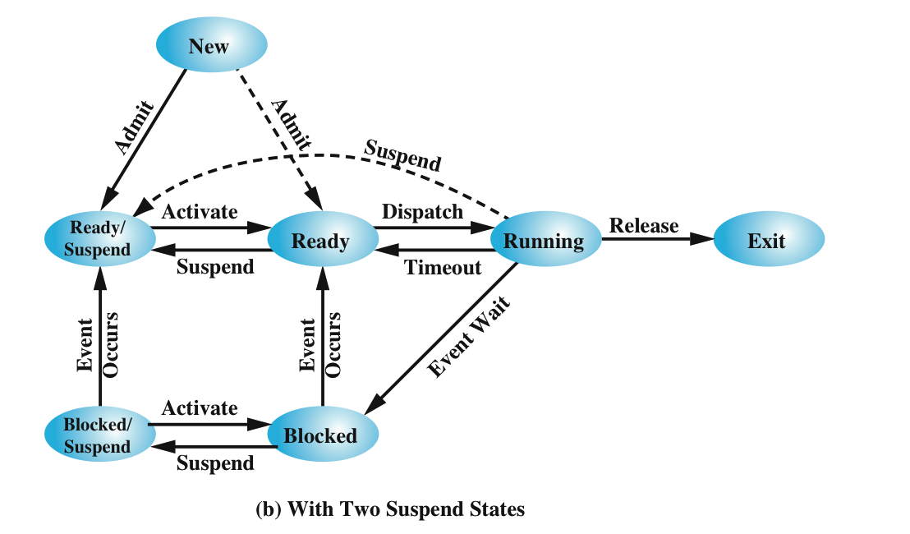
Notes:
Let us look now, in Figure 3.9b , at the state transition model that we have
developed. (The dashed lines in the figure indicate possible but not necessary transitions.)
Important new transitions are the following:
• Blocked : Blocked/Suspend: If there are no ready processes, then at least
one blocked process is swapped out to make room for another process that
is not blocked. This transition can be made even if there are ready processes
available, if the OS determines that the currently running process or a ready
process that it would like to dispatch requires more main memory to maintain
adequate performance.
• Blocked/Suspend : Ready/Suspend: A process in the Blocked/Suspend state
is moved to the Ready/Suspend state when the event for which it has been
waiting occurs. Note that this requires that the state information concerning
suspended processes must be accessible to the OS.
• Ready/Suspend : Ready: When there are no ready processes in main memory,
the OS will need to bring one in to continue execution. In addition, it
might be the case that a process in the Ready/Suspend state has higher priority
than any of the processes in the Ready state. In that case, the OS designer may
dictate that it is more important to get at the higher-priority process than to
minimize swapping.
• Ready : Ready/Suspend: Normally, the OS would prefer to suspend a
blocked process rather than a ready one, because the ready process can now
be executed, whereas the blocked process is taking up main memory space
and cannot be executed. However, it may be necessary to suspend a ready
process if that is the only way to free up a sufficiently large block of main
memory. Also, the OS may choose to suspend a lower–priority ready process
rather than a higher–priority blocked process if it believes that the blocked
process will be ready soon.

Slide 20
Communications Models
(a) Message passing. (b) shared memory.
Notes:
Mechanism for processes to communicate and to synchronize their actions
Message system – processes communicate with each other without resorting to shared variables
IPC facility provides two operations:
send(message)
receive(message)
The message size is either fixed or variable
An area of memory shared among the processes that wish to communicate
The communication is under the control of the users processes not the operating system.
Major issues is to provide mechanism that will allow the user processes to synchronize their actions when they access shared memory.
Synchronization is discussed in great details in Chapter 5.
Processes within a system may be independent or cooperating
Cooperating process can affect or be affected by other processes, including sharing data
Reasons for cooperating processes:
Information sharing
Computation speedup
Modularity
Convenience
Cooperating processes need interprocess communication (IPC)
Two models of IPC
Shared memory
Message passing

Slide 21
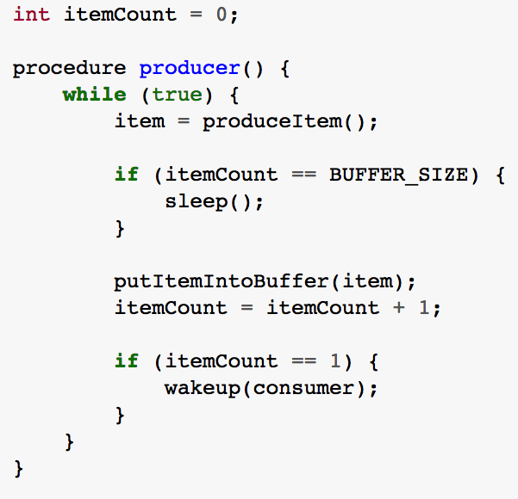
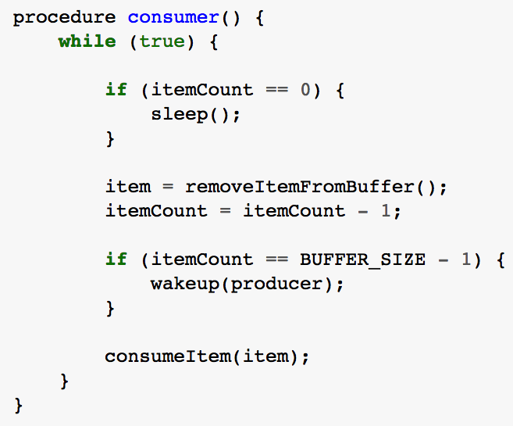
Producer-Consumer Problem An Inadequate Solution
Notes:
Producer-consumer problem is a classic example of a multi-process synchronization problem.

Slide 22
Examples of IPC Systems – POSIX POSIX Shared Memory
Process first creates shared memory segment shm_fd = shm_open(name, O CREAT | O RDWR, 0666);
Also used to open an existing segment to share it
Set the size of the object
ftruncate(shm_fd, 4096);
Now the process could write to the shared memory
sprintf(shared memory, "Writing to shared memory");

Slide 23
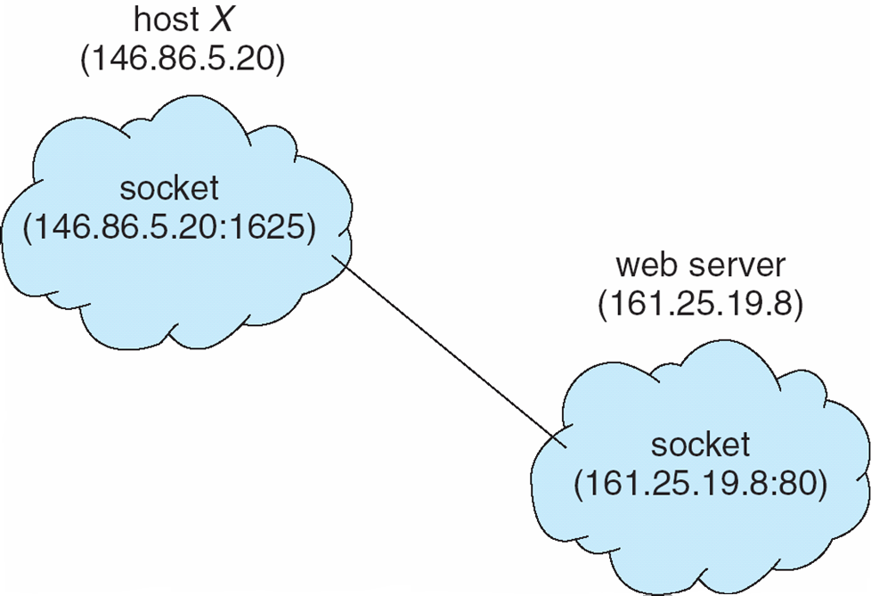
Socket Communication

Slide 24
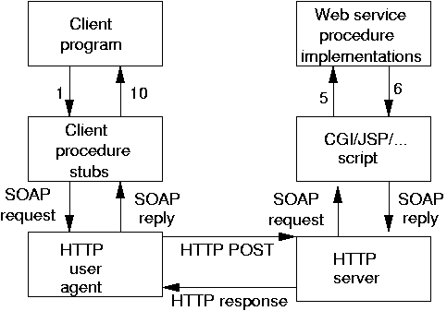
Remote Procedure Calls
Notes:
Remote procedure call (RPC) abstracts procedure calls between processes on networked systems
Again uses ports for service differentiation
Stubs – client-side proxy for the actual procedure on the server
The client-side stub locates the server and marshalls the parameters
The server-side stub receives this message, unpacks the marshalled parameters, and performs the procedure on the server
On Windows, stub code compile from specification written in Microsoft Interface Definition Language (MIDL)

